Slide 1
Wind Turbine Power Prediction.
Vishal Vasoya : 202118013
Nidhi Sadhwani : 202118043

Slide 2
TABLE OF CONTENTS
PROJECT AIM
DATASET
DATA PREPARATION
DATA VISUALISATION
REGRESSION MODEL
LINEAR REGRESSION
GRADIENT BOOST TREE
CONCLUSION

Slide 3
PROJECT AIM
Globally wind power has seen considerable growth in all grid systems. In the coming decade wind power is also expected to expand rapidly.
Nowadays many of the real world problems are being solved using artificial intelligence(AI) and data science techniques.
So in this project, we are using machine learning Regression models to predict a wind turbine power production by using the wind speed, wind direction, month and hour data.

Slide 4
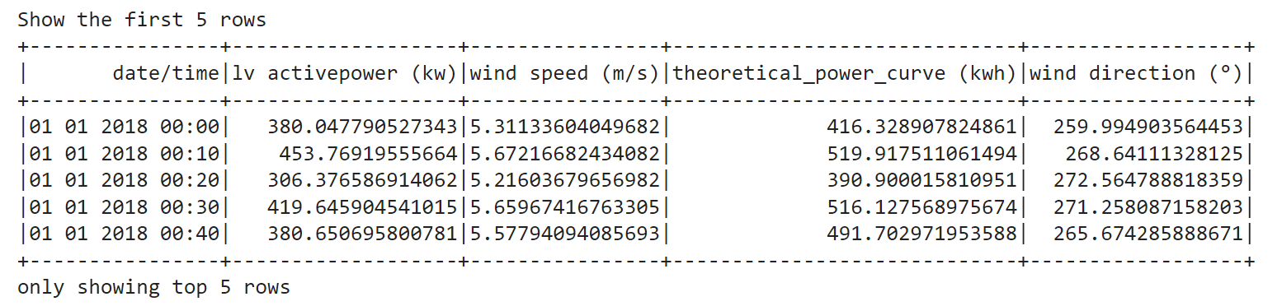
DATASET
The dataset consists of 50530 observations and 5 input features as follows:
Date/Time (for 10 minutes intervals).
LV Active Power (kW): The power generated by the turbine for that moment.
Wind Speed (m/s): The wind speed at the hub height of the turbine (the wind speed that turbine use for electricity generation)
Theoretical Power Curve (kWh): The theoretical power values that the turbine generates with that wind speed which is given by the turbine manufacturer.
Wind Direction (°): The wind direction at the hub height of the turbine (wind turbines turn to this direction automatically.

Slide 5
DATA PREPARATION
Rearranging of columns
Removing Outliers
Limiting record values

Slide 6
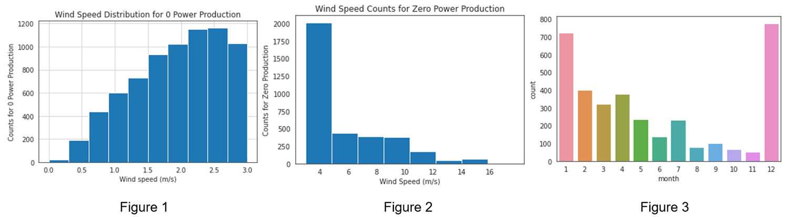

Slide 7
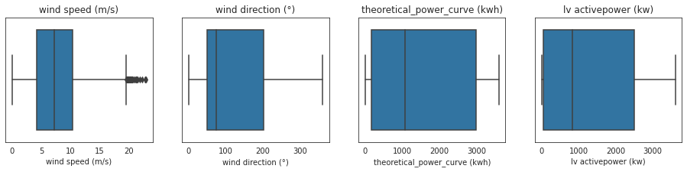
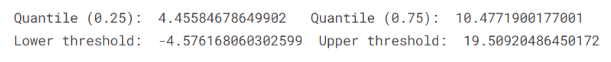

Slide 8
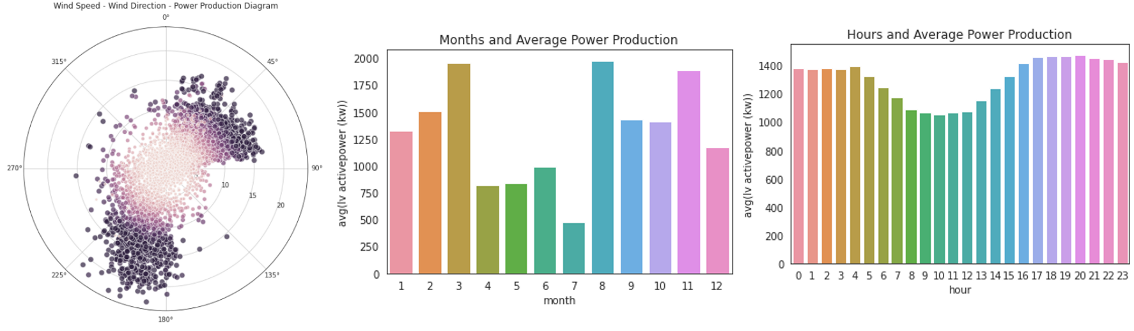
DATA VISUALISATION
1. The power production is higher when the wind blows from the directions between 000-090 and 180-225 degrees.
2. We saw from the graph that in March, August and November, the average power production is higher.
3. The average power production is higher daily between 16:00 and 24:00.

Slide 9
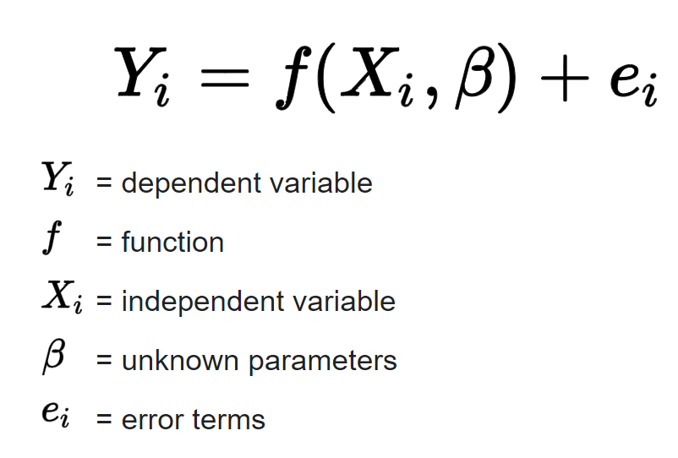
Regression Model
Regression is a machine learning algorithm based on supervised learning. It performs a regression task. It provides a function that describes the relationship between one or more independent variables and a response, dependent, or target variable. The variable you want to predict is called the dependent variable. The variable you are using to predict the other variable's value is called the independent variable.
Regression theorem is stated mathematical as following:

Slide 10
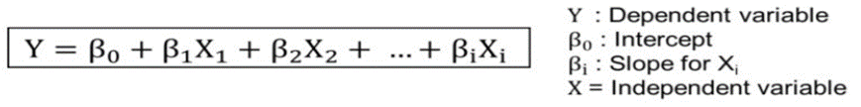
Linear Regression
Linear Regression Model has two categories: Simple and Multiple. Since our dataset has multiple features so we need to apply Multiple Linear Regression model in our project. Regression allows us to estimate how a dependent variable changes as the independent variable(s) change. This is used to estimate the relationship between two or more independent variables and one dependent variable.
Multiple Linear Regression theorem is stated mathematical as following:

Slide 11
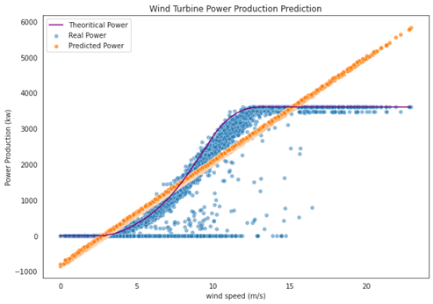

Slide 12
Gradient Boost Tree
In order to minimize a loss function, Gradient Boosting Trees (GBTs) iteratively train many decision trees. On each iteration, the algorithm uses the current ensemble to predict the label of each training instance.
Note: Validation while training: Gradient boosting can overfit, especially when you have trained your model with more trees. In order to prevent this issue, it is useful to validate while carrying out the training.

Slide 13
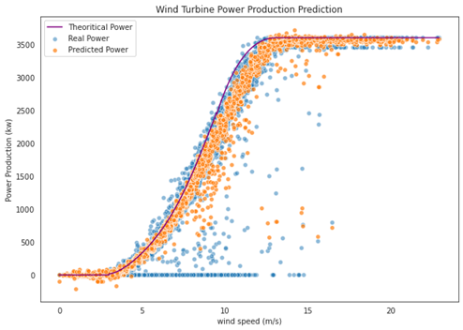

Slide 14


Conclusion
A linear regression gives r square score of 0.88 which is good but not best for our data. Our data is non linear that’s why it give a best fit line which is missing some of the actual data point at the bottom and top of the data point. As per our conclusion we need a model which give a non-linear line that is give best fit curve.
GBT Regressor gives r square score of 0.98 which is best for our data. As per figure of gradient boost tree regression gives a non-linear line which give best fitting between actual data and predicting data.

